Slide 1

Vel Tech Rangarajan Dr. Sagunthala R&D Institute of Science and Technology
School of Computing
Department of Computer Science and Engineering
10211CS224 / FULL STACK APPLICATION DEVELOPMENT (JAVA)
PROJECT REVIEW : MILESTONE PROJECT – 2
Date: 22-04-2026
Full Stack Event Ticket Booking System
SDG 9 – Industry, Innovation and Infrastructure
Presented By:
SHAIK SANHEERA– VTU26379 –23UECS1205
Courses Handling Faculty:
Dr. S. Manohar ME.,(Phd)
Assistant Professor

Slide 2
INTRODUCTION
1
This project is a dynamic, full-stack web application designed to streamline the process of discovering and booking tickets for various college events (Technical, Non-Technical, and Workshops).
It provides a seamless user experience for students to register, browse events, and secure their spots, while providing organizers with an automated way to manage ticket availability.
2
3
4
5
6
7
8

Slide 3
PROBLEM STATEMENT
Manual and Time - Consuming: Booking tickets requires manual work, which takes more time and slows down the process.
Long Queues : Users often stand in long lines, especially during peak times, causing inconvenience.
Poor Record Management: Maintaining records manually can lead to errors, data loss, and duplication.
Limited Accessibility : Booking is only available at specific places and times, reducing user convenience.
Difficulty in Tracking : Users cannot easily check ticket availability or booking status in real time.
Inefficient for Large Users : The system cannot handle a large number of users effectively during high demand.
Higher Chances of Errors : Manual data entry may lead to mistakes in booking details.
1
2
3
4
5
6
7
8
9

Slide 4
OBJECTIVE(S)
1
Objective 1:To develop an online platform that allows users to book tickets easily and quickly from anywhere at any time.
Objective 2:To reduce manual effort and waiting time by automating the ticket booking process.
Objective 3:To maintain and manage booking records efficiently with proper data storage and retrieval.
2
3
4
5
6
7
8
9

Slide 5
PROPOSED SYSTEM
Centralized Event Hub: Instead of relying on physical notice boards or scattered WhatsApp messages, the proposed system provides a single, unified dashboard where students can discover all upcoming Technical, Non-Technical, and Workshop events.
Real-Time Inventory Management: The system utilizes MongoDB to actively track ticket availability. When a student books a ticket, the available capacity decreases instantly, entirely eliminating the risk of overbooking or double-booking.
Secure User Authentication: Implementing JSON Web Tokens (JWT) and Bcrypt password hashing ensures that user data is highly protected. Only verified students can log in and perform sensitive actions like booking tickets.
Automated Ticket Generation: Upon successful registration for an event, the system automatically generates a digital receipt/ticket, providing instant confirmation to the user without any manual intervention from organizers.
Interactive & Responsive UI: Built with React and enhanced with Framer Motion animations, the system guarantees a smooth, modern, and mobile-friendly experience across all devices.
1
2
3
4
5
6
7
8
9

Slide 6
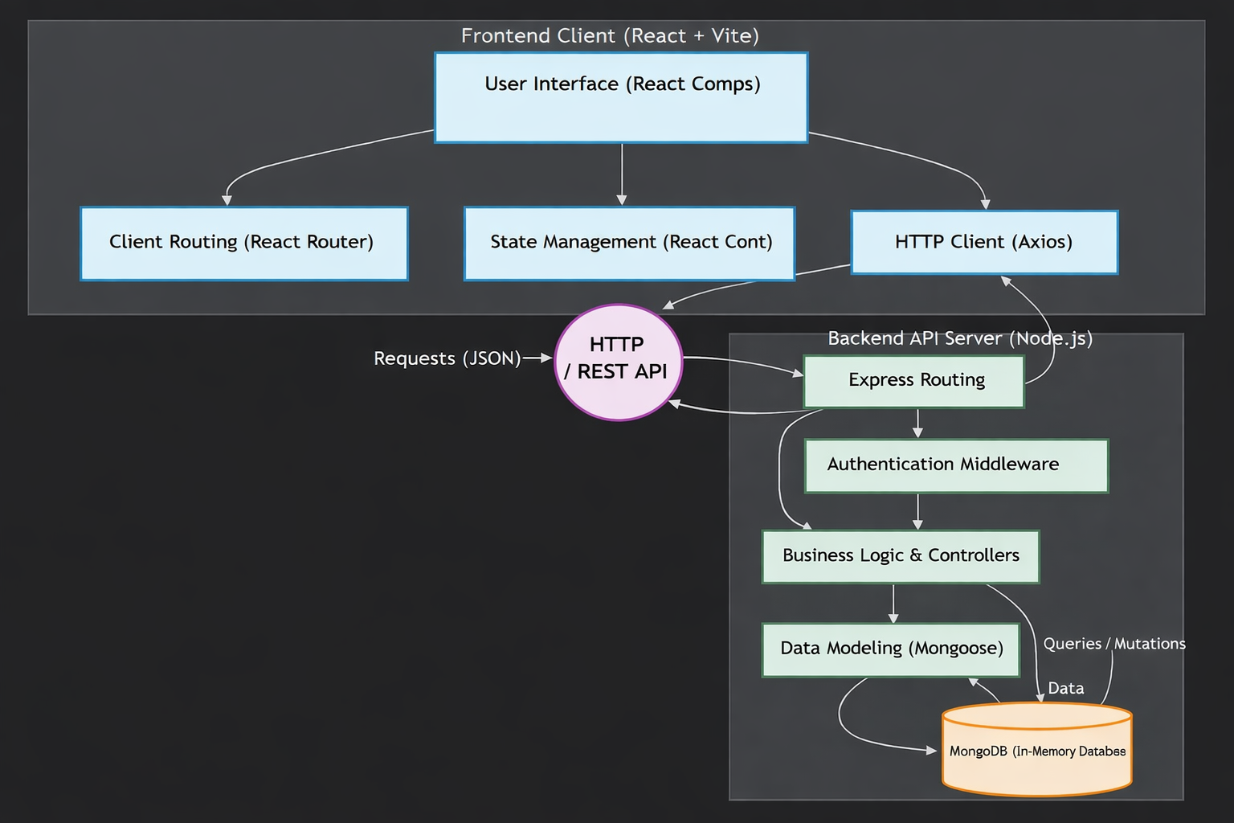
PROPOSED SYSTEM ARCHITECTURE
Block Diagram:
1
2
3
4
5
6
7
8
9

Slide 7
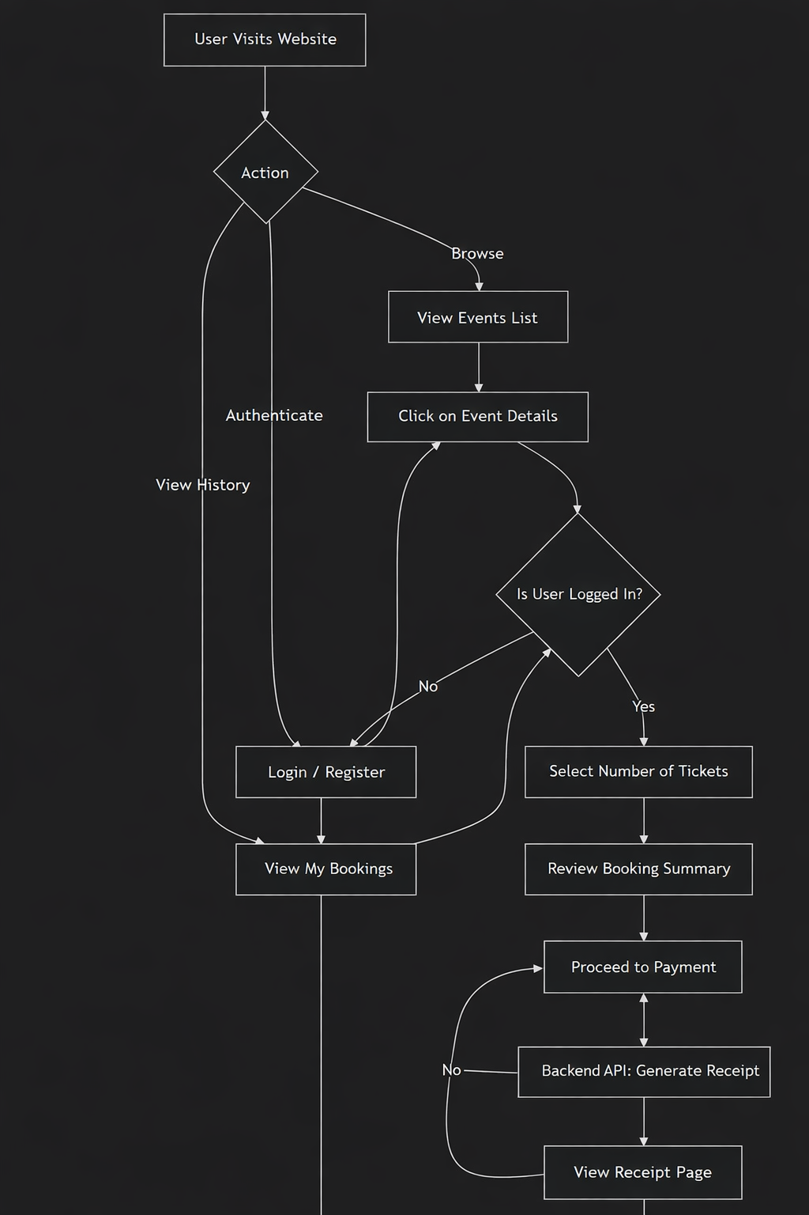
WORKFLOW
Data Flow Diagram:
1
2
3
4
5
6
7
8
9

Slide 8
TECHNOLOGIES USED
1
Frontend: React JS, HTML5, CSS3,Javascript.
Backend: Node.js, Express.js
Database: Mongodb
Hardware Requirements:
Processor: Intel i3 or above
RAM: 4 GB or above
Operating System: Windows / Linux / macOS
Software Requirements: Node.js ,Npm, Web Browser (Chrome/Edge/Firefox)
2
3
4
5
6
7
8
9

Slide 9
MODULE DESCRIPTION
A. User Authentication Module
Registration: Captures user details, encrypts their password, and creates a new document in the MongoDB users collection.
Login: Verifies credentials, compares the hashed password, and issues a JWT if successful.
Authorization: Protects specific pages (like the Payment/Booking page) so only logged-in users can access them.
B. Event Management Module
Event Catalog: Fetches all available events from the database and displays them dynamically.
Filtering: Allows users to categorize events (e.g., only showing Technical events or Workshops).
Event Details: Displays comprehensive information for a single event, including dates, venues, remaining capacity, and pricing.
C. Booking & Ticket Module
Transaction Handling: Processes the user's request to book a ticket.
Inventory Management: Automatically decrements the availableTickets count in the database in real-time to prevent overbooking.
Receipt Generation: Generates a digital ticket/receipt for the user once the booking is confirmed.
1
2
3
4
5
6
7
8
9

Slide 10
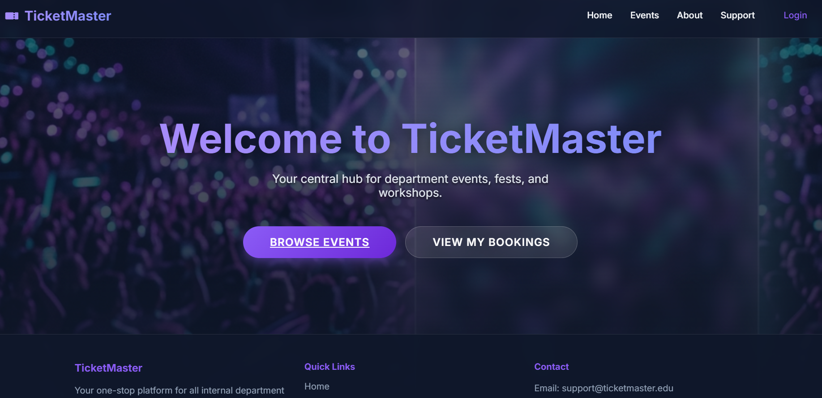
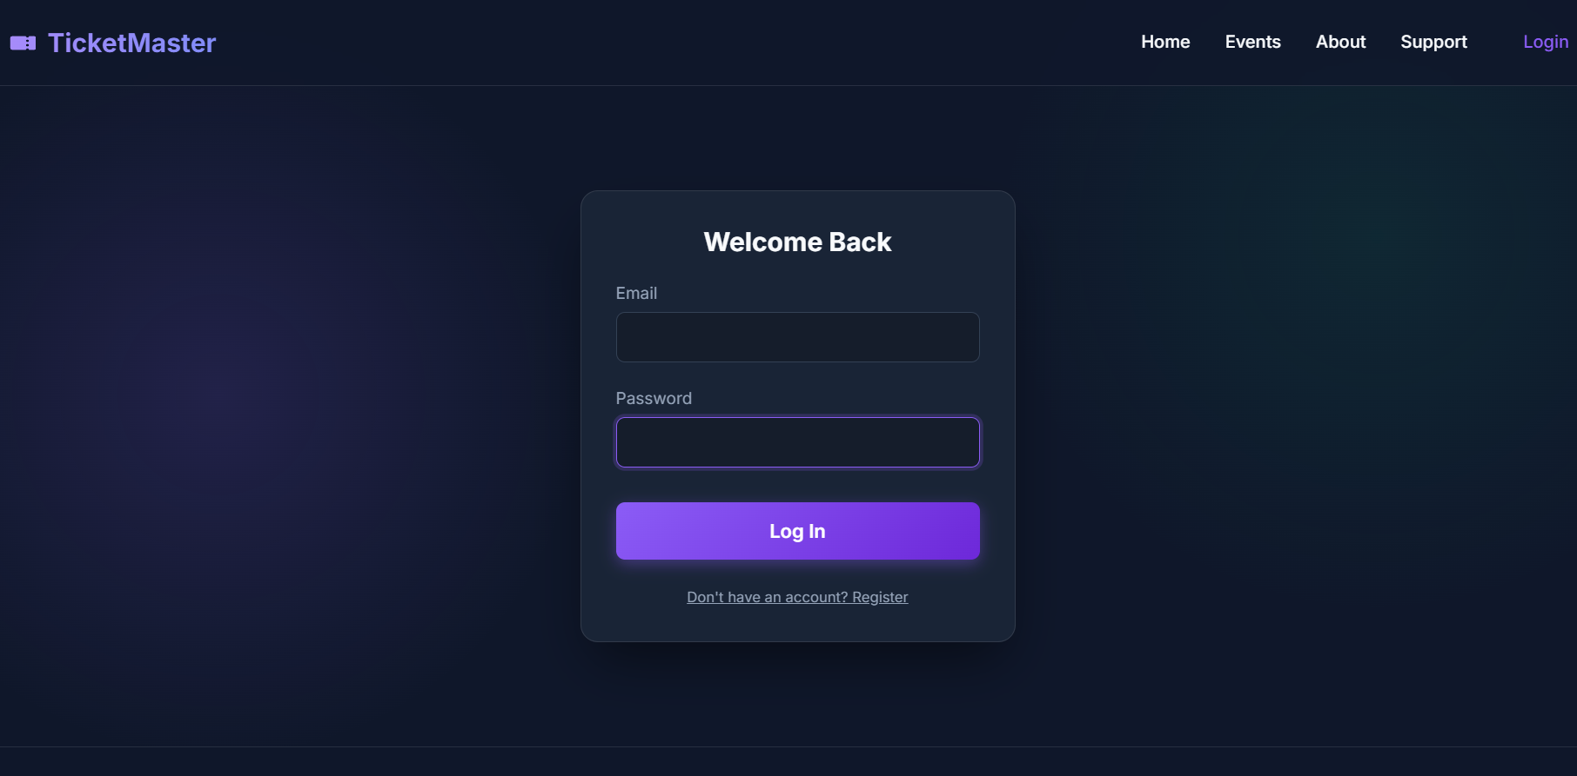
IMPLEMENTATION SCREENSHOTS
Home page:
The user/admin can view the homepage where they cam browse events and see their bookings
1
2
3
4
5
6
7
Login page:
The user can login to so that they can access the event tickets and bookings securely. And admin can login to manage events , bookings.
8
9

Slide 11
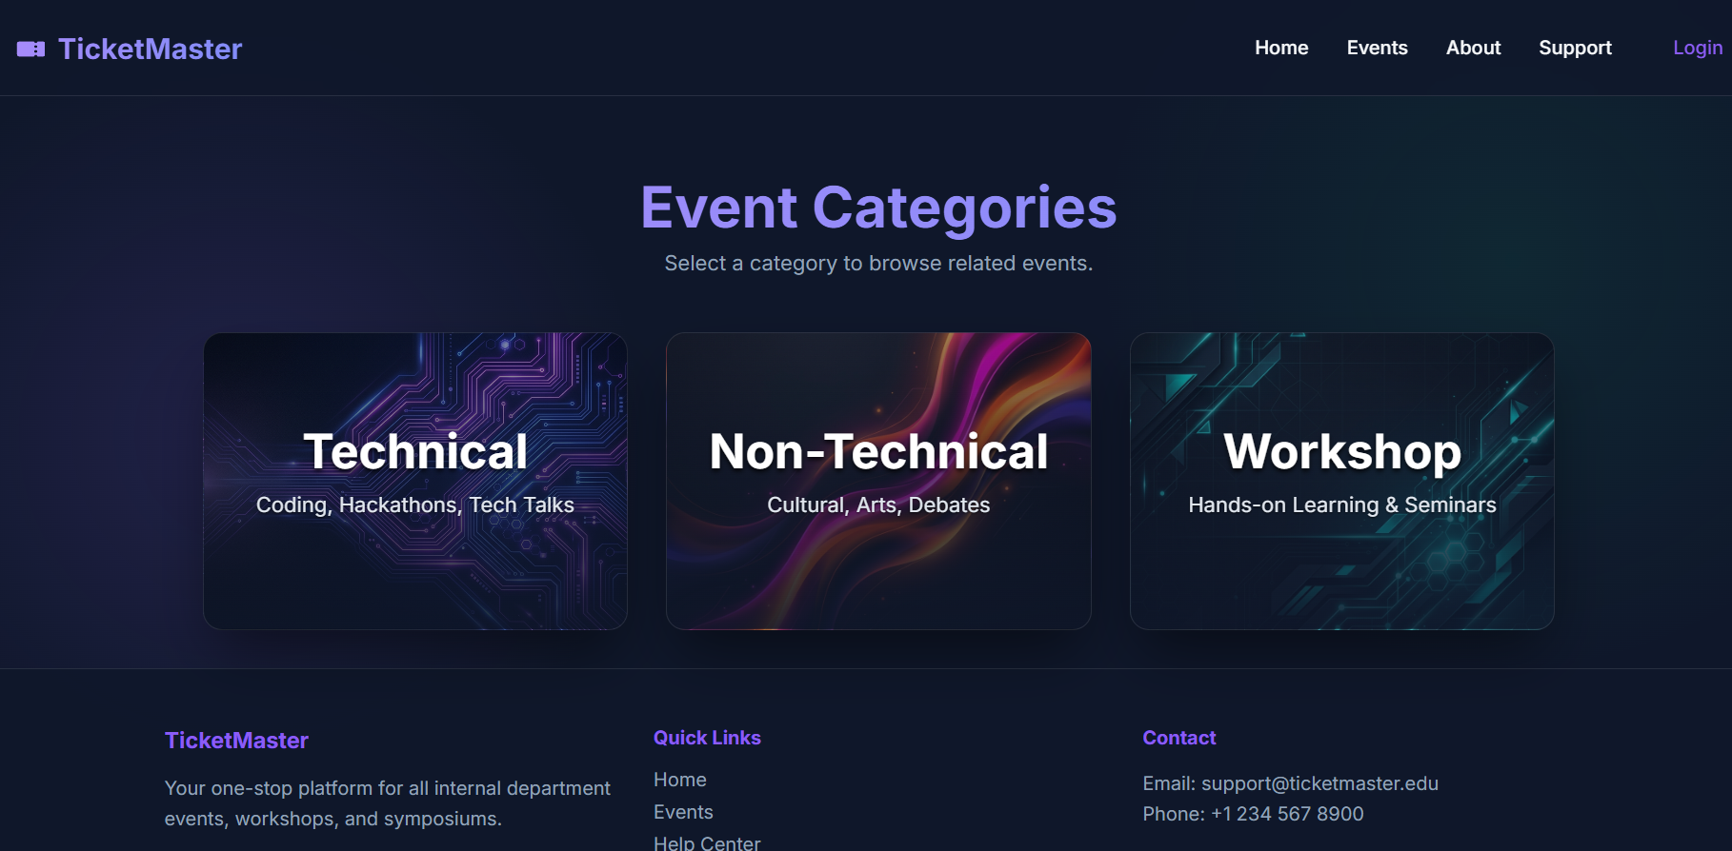
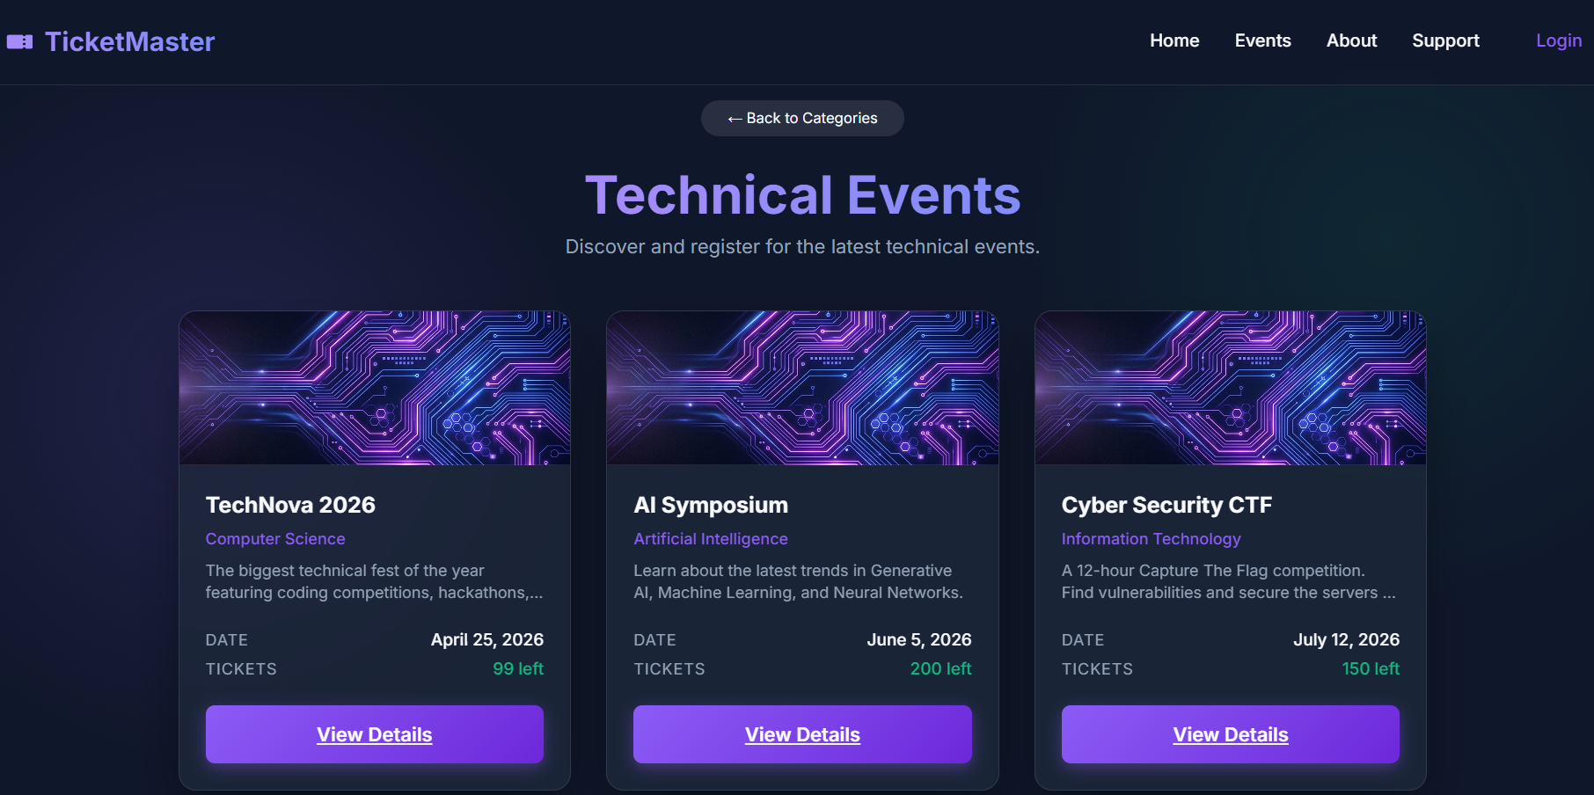
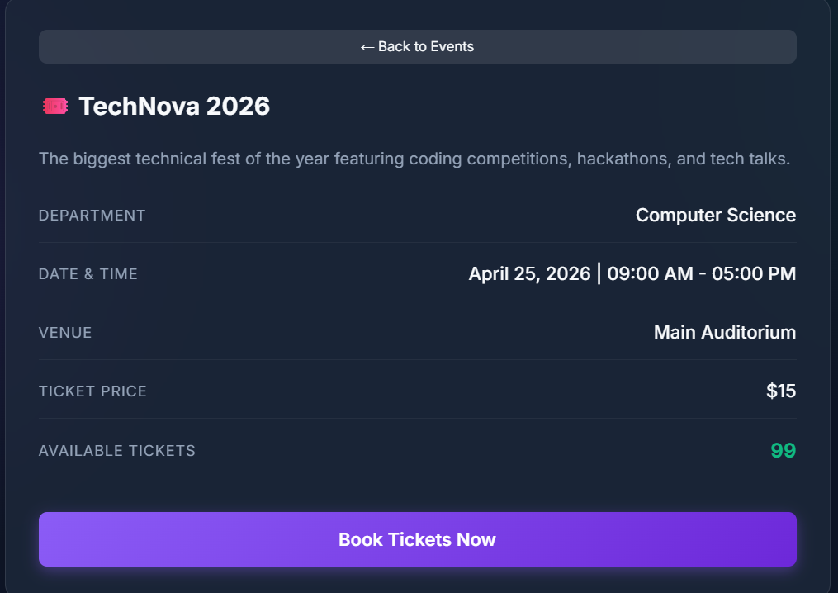
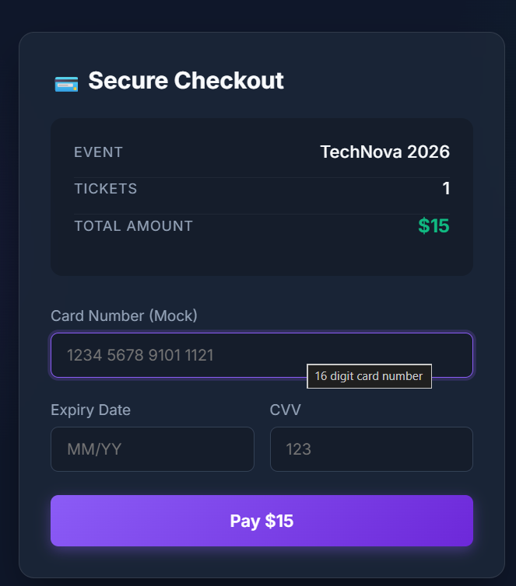
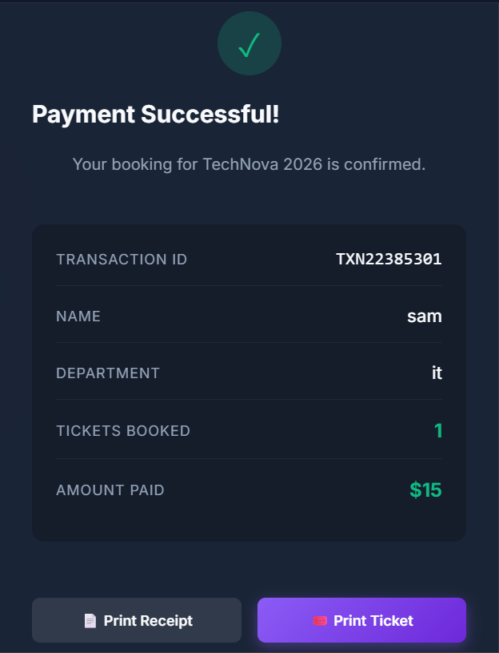
IMPLEMENTATION SCREENSHOTS
1
2
3
4
5
6
7
8(A)
9

Slide 12
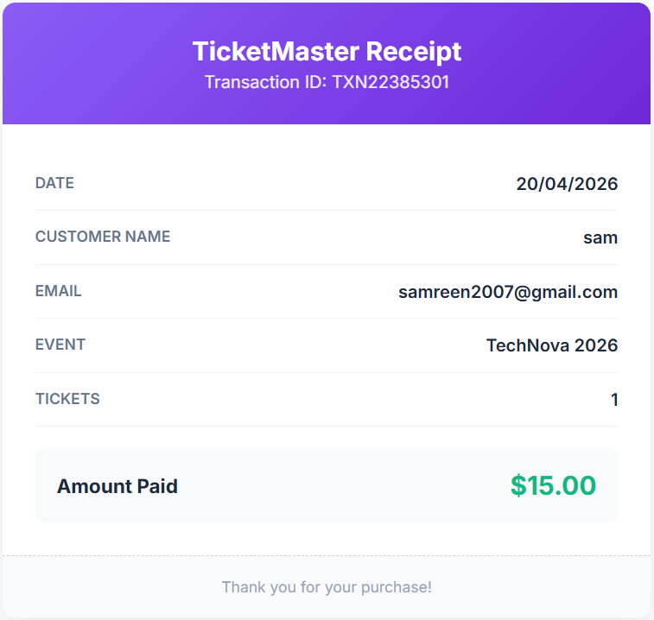
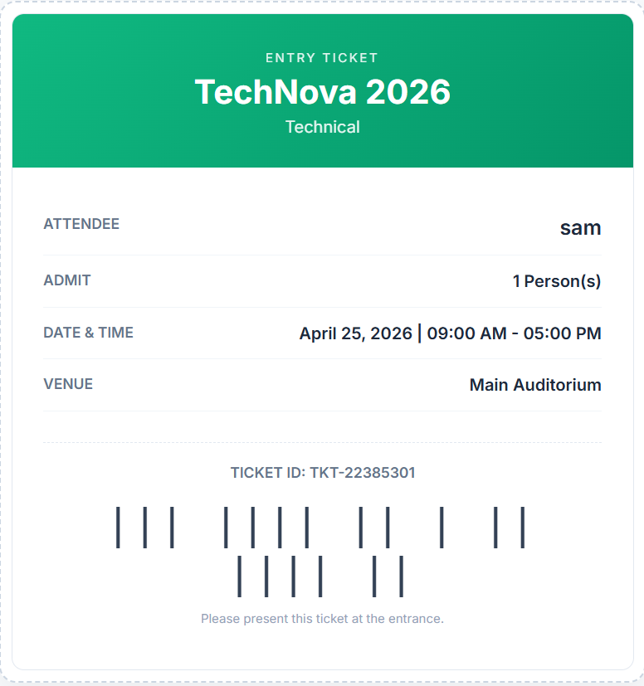
IMPLEMENTATION SCREENSHOTS
1
2
3
4
5
6
7
8(B)
9

Slide 13
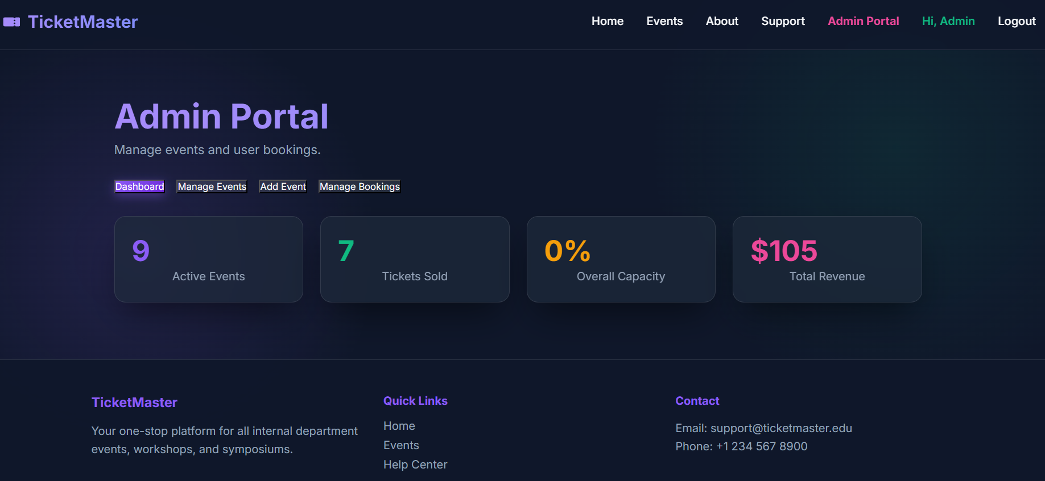
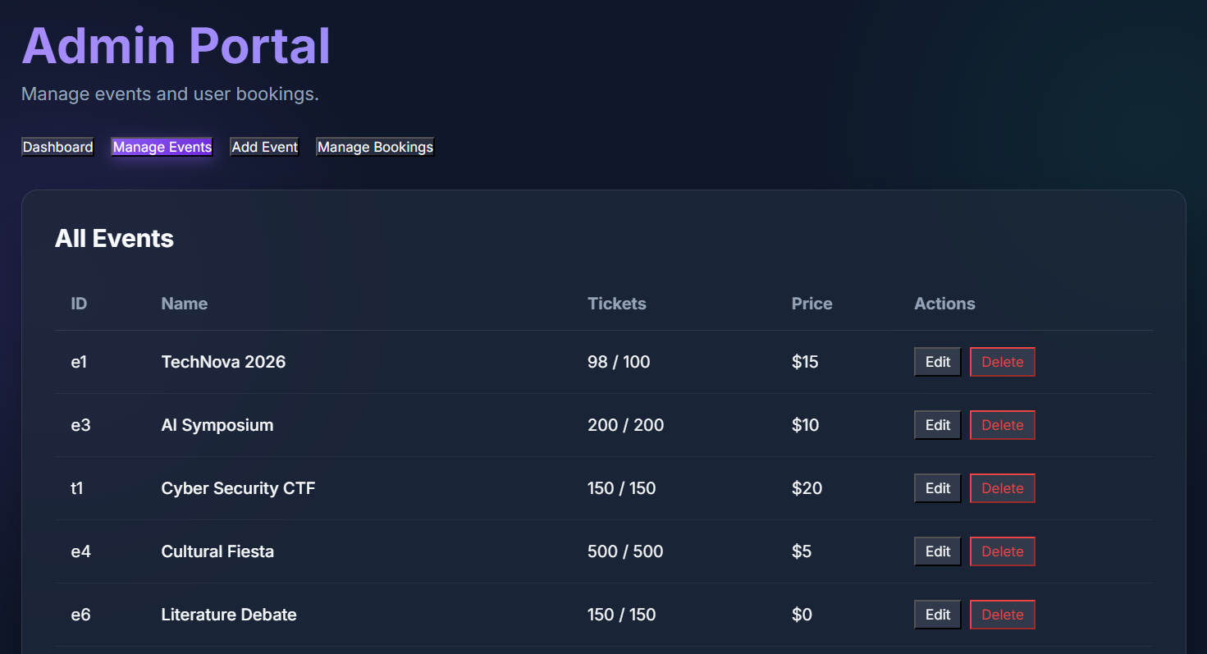
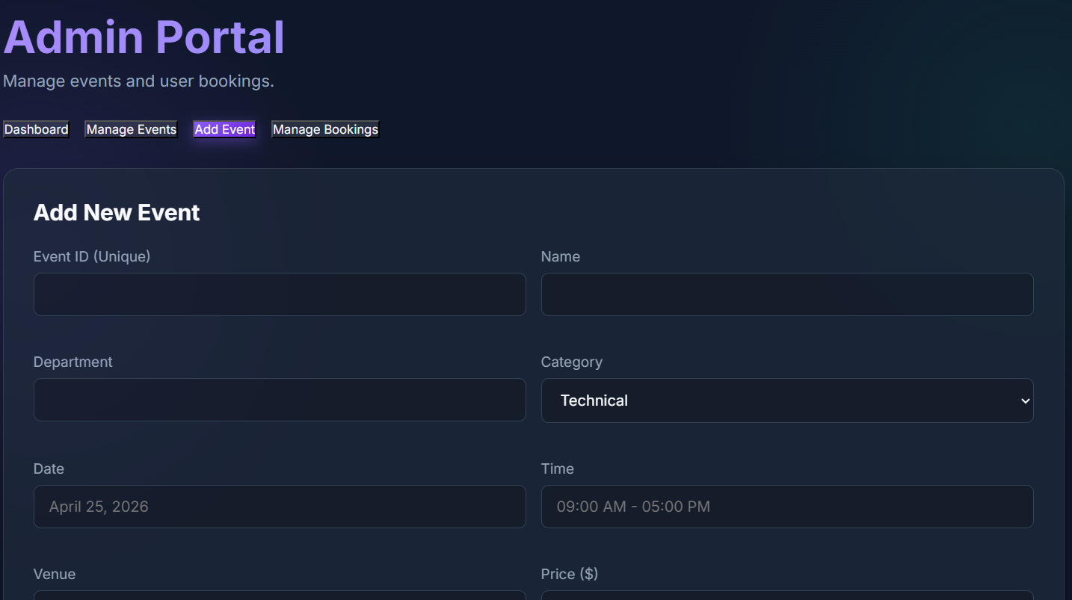
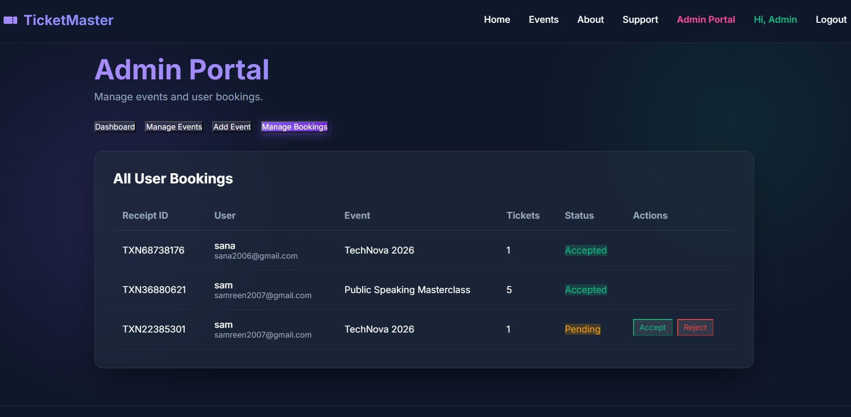
IMPLEMENTATION SCREENSHOTS
1
2
3
4
5
6
7
8(C)
9

Slide 14
ADVANTAGES & LIMITATIONS
1
Advantages:
Easy and convenient booking from anywhere.
Saves time by avoiding long queues.
User-friendly interface for smooth navigation.
Quick access to event details and availability.
Reduces manual errors in booking process.
Efficient data management with digital records.
Limitations:
Requires internet connection to access the system.
No payment integration.
Dependent on system performance and browser.
No real-time seat availability .
Basic functionality compared to real-world systems.
2
3
4
5
6
7
8
9

Slide 15
Thank you

